Slide 1
**** COMMODORE 64 BASIC V2 ****
64K RAM SYSTEM 38911 BASIC BYTES FREE
READY.
RETRO AI
AI ALGORITHMS ON THE COMMODORE 64
AND HOW THEY APPLY TO MODERN AI
RACHEL APPEL

Slide 2
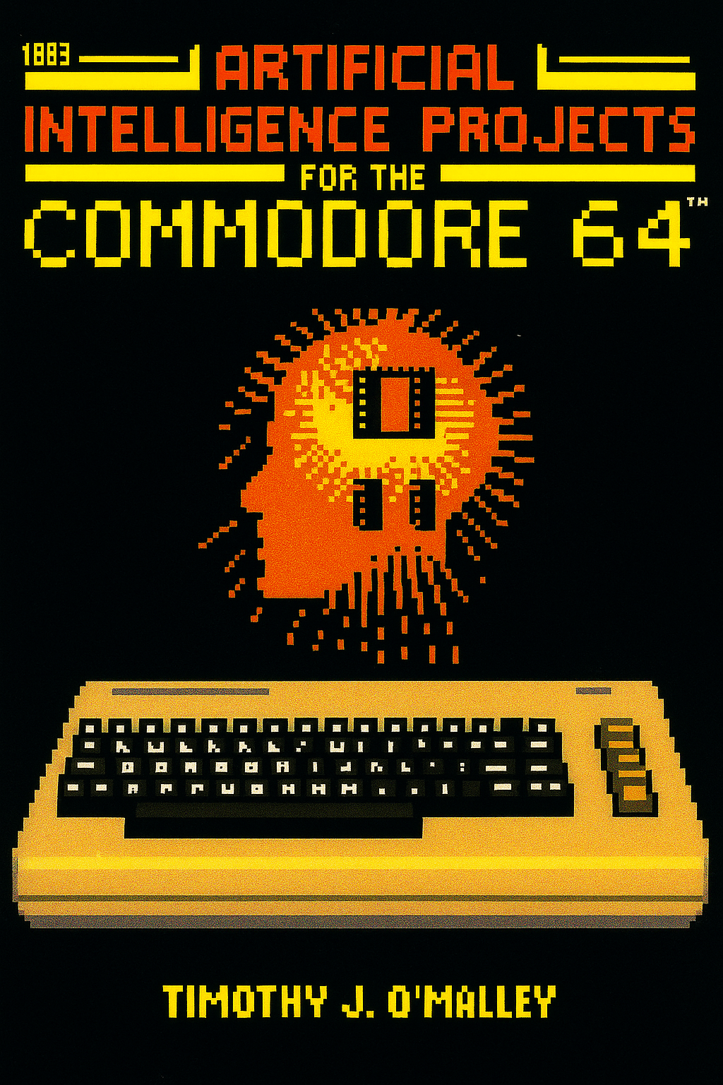


Book @ archive.org
https://jb.gg/AI-C64-Book
Repo with BASIC programs
https://jb.gg/AI-64
Notes:
About this talk
Point out that LLMs aren’t the only thing that is AI – Far from it!
Demonstrate the AI effect and how programs that were considered AI in the past (even in the recent past) are no longer considered AI.
We’re not here to learn how to program BASIC, but might look at a few samples
We’re not here to learn how to program algorithms, but to see how they shaped modern AI
We can’t just make 1:1 direct lines from the C64 code here to LLMs/AI systems.
Much of the code here are using classic compsci algorithms. Guess what? All AI, including LLMs, use classic compsci algos.

Slide 3
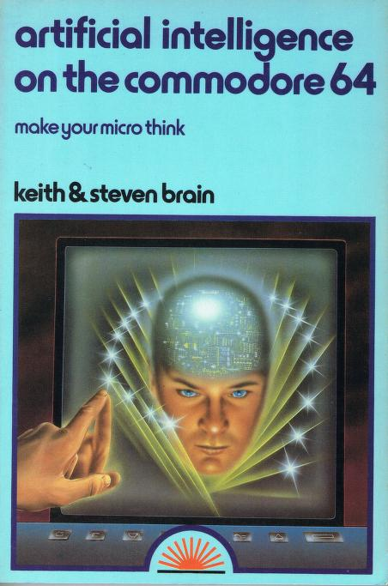
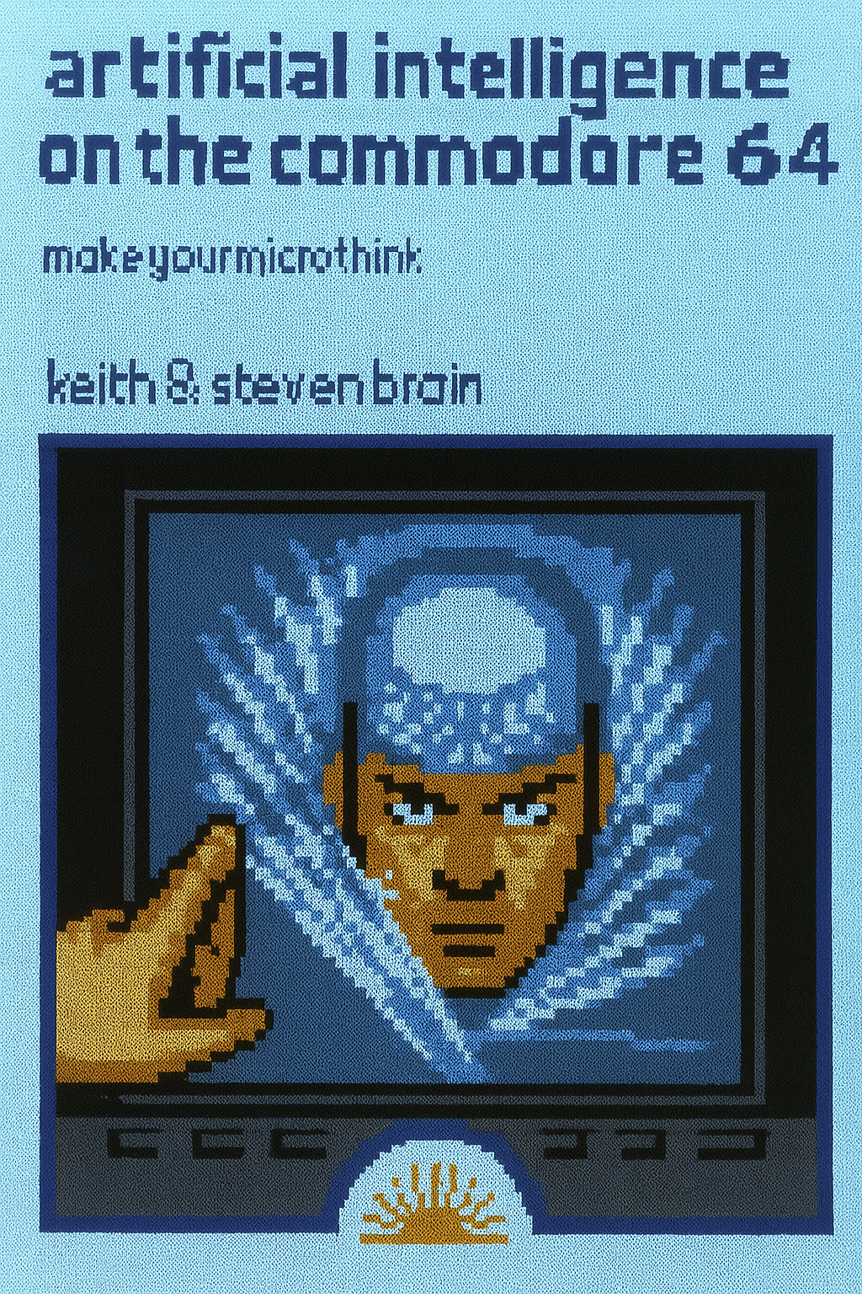
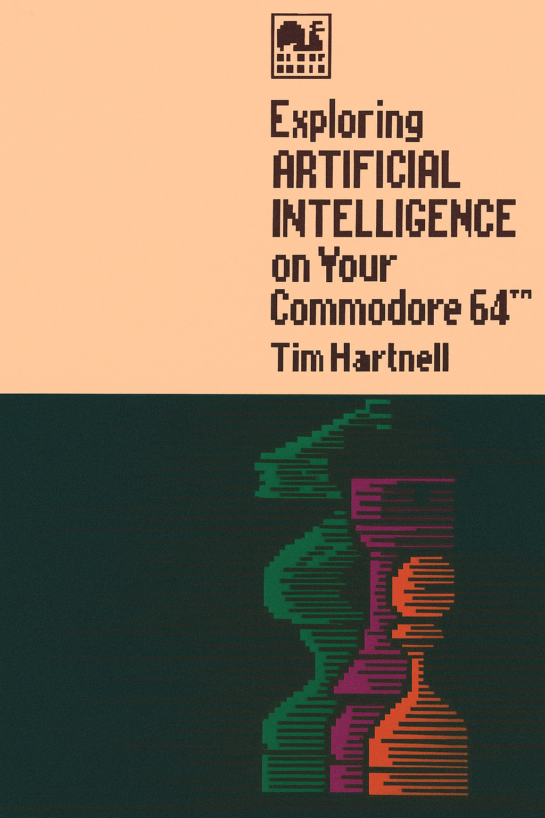
https://jb.gg/AI-C64-Microthink
https://jb.gg/Explore-AI-C64
And more Retro AI books at Archive.org for the Apple II, Spectrum, Sinclair QL, and IBM PC.
Notes:
Exploring Artificial Intelligence on your Commodore 64.pdf
Artificial intelligence on the Commodore 64 : make your micro think : Brain, Keith : Free Download, Borrow, and Streaming : Internet Archive
Tim Hartnell also wrote “Exploring AI” books for the Sinclair QL, the (ZX) Spectrum, IBM PC, and Apple II

Slide 4
HOME COMPUTING
Notes:
During the era of Bill Gates saying he’s striving to get a “computer on every desk and in every home”
In 1985 there were no data centers; though we did have mainframes
Personal home computers like the C64 had 64K of RAM and a 1Mhz processor (yes K not Gb MHz not GHz) and NO HARD DRIVE
Therefore, not all algorithms could do what they do today.
But if they had enough or infinite time, storage space, and/or resources, some very well could.

Slide 5
ARTIFICIAL INTELLIGENCE
Notes:
LLMs aren’t the only thing that is AI – Far from it!
“large language model” doesn’t sound as appealing or SciFi-y as “artificial intelligence”.
AI is a broad category of software
It includes LLMs, Expert systems, robotics, and others
It’s not new. AI has been in many products for decades now. (autocorrect, navigation, robotics, etc…)
There aren’t necessarily direct lines from the programs in this talk straight to modern AI algorithms.
Some have conceptually influenced, and others do actually use these same algorithms in part.

Slide 6
“The science of making machines do things that would require intelligence if done by people.”
John McCarthy

Slide 7
“Artificial intelligence is the attempt to set machines to perform processing abilities normally associated only with cognitive human thought. It is artificial in the sense that it is a manufactured technique and may not have the same basis as human intelligence.”
“What is important is that the results of human and artificial intelligence are highly similar.”
Notes:
Emotions are a core part of human intelligence and machines simply do not possess them.

Slide 8
“All of the rules of computer science apply to the field of artificial intelligence. Don't expect that you can somehow transform your Commodore 64 into an electronic personality.”
Notes:
These rules are called “algorithms”

Slide 9


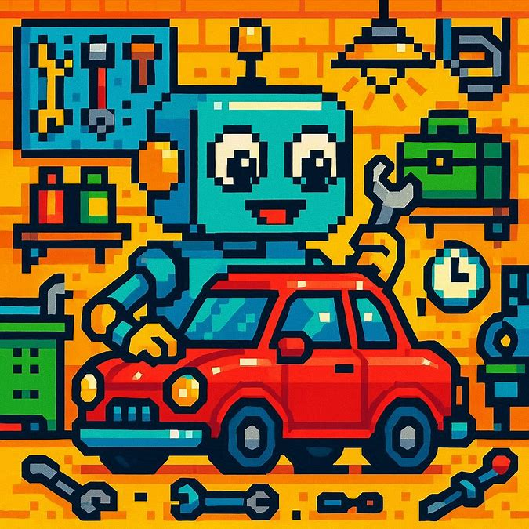


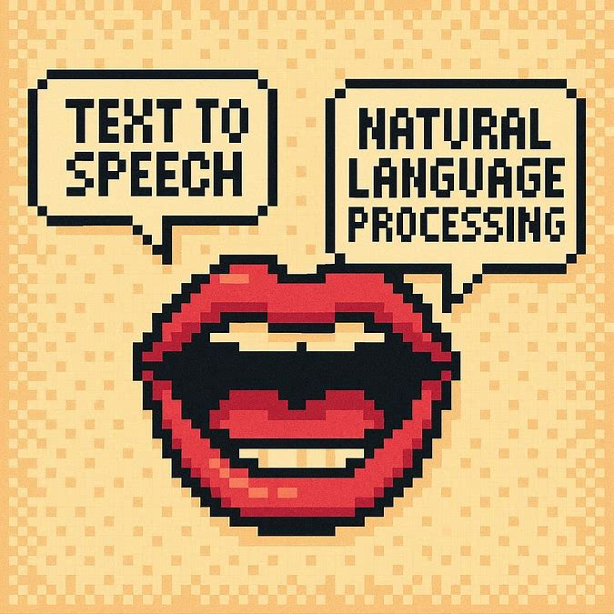
Notes:
Machine Learning (ML): Algorithms that learn from data (supervised, unsupervised, reinforcement learning).
Deep Learning: Neural networks with many layers, powering vision, speech, and NLP systems.
Natural Language Processing (NLP): Understanding and generating human language (chatbots, translation, sentiment analysis).
Computer Vision: Analyzing and interpreting visual data (facial recognition, object detection).
Robotics: Physical machines using AI to perceive, plan, and act.
Expert Systems / Knowledge-Based Systems: Rule-based reasoning for decision support.
Speech Recognition & Generation: Converting speech to text and vice versa.
Recommender Systems: Personalized suggestions based on user behavior.
Autonomous Systems: Self-driving cars, drones, industrial automation.

Slide 10
ALGORITHMS
Notes:
Algorithm
A process or set of rules to be followed in calculations or other problem-solving operations, especially by a computer.
It’s never just “the algorithm” like people like to say, meaning one big algo. This is a way for laypeople and professionals alike to use computing terms to get the gist of what’s going on. LLMs, other types of AI, and algos from social media like YouTube or Facebook are commonly said like “YouTube’s algorithm” but in reality, they use many algorithms to get their work done.

Slide 11
TOWERS OF HANOI
Notes:
The Towers of Hanoi is a classic mathematical puzzle that involves moving a stack of discs from one peg (or rod) to another, following specific rules. The puzzle consists of three pegs and a set of discs of varying sizes, which are initially stacked on one peg in descending order, from largest at the bottom to smallest at the top. The goal is to move the entire stack of discs to another peg, usually the last one, while adhering to two key rules: (1) only one disc can be moved at a time, and (2) no larger disc can be placed on top of a smaller disc. A recursive solution is often used to solve the puzzle: first, the smaller stack of discs above the largest one is moved to an auxiliary peg, then the largest disc is moved directly to the destination peg, and finally, the smaller stack is moved from the auxiliary peg to the destination peg. The minimum number of moves required to solve the puzzle is (2^n - 1), where (n) is the number of discs. This recursive and algorithmic structure makes the Towers of Hanoi a foundational problem in computer science and mathematics for understanding recursion.

Slide 12
Towers of Hanoi
Binary rule
Recursive problem solving
State-space representation
Notes:
-----------Key points of the BASIC program------------
The code block systematically identifies the disk to move during the current step by analyzing the move counter NM using bitwise operations; it checks each bit position (S) to determine if the corresponding disk should be moved, increments S for the next iteration, and loops until a valid disk (D) is found.
Line 510: Calculate the total number of moves (T(1) = 2^N - 1) for the puzzle.
Line 520: Increment the move counter (NM) and initialize the disk selector (S=0).
Lines 530-540: Determine which disk (D) to move based on bitwise logic from the move counter.
Lines 540-550: Identify the source post (TF) where the disk currently resides.
Line 560: Calculate the change in post position (DT) based on disk and move properties.
Line 570: Compute the destination post (TT) using arithmetic and logical operations.
Lines 580-590: Update the states of the source and destination posts by subtracting and adding the disk (using powers of 2 for disk representation).
Line 600: Call the subroutine to display and animate the disk motion (GOSUB 700).
Line 610: Repeat the process (GOTO 520) until all moves are completed (NM < 2^N-1).
Line 620: Print "DONE." upon completing the puzzle and exit.
T is the array representing the posts
NM is the move counter
S is the position
D is the disk
-------------Algorithmic information------------------
Recursive problem solving is a technique in which a problem is broken down into smaller subproblems of the same type, solving each subproblem iteratively or recursively until reaching a base case, which is simple enough to be solved directly. This method allows for an elegant and systematic approach to solving problems that exhibit a repetitive or self-similar structure. For example, in recursion, a function often calls itself with a reduced version of the original input, gradually working toward the base case.
State-space representation is a method used in artificial intelligence (AI), computer science, and mathematics to model and solve complex problems by defining all possible states of a system, the transitions between states, and the goal state(s). State-space representation abstracts a problem into a formal, mathematical framework, where the focus is on exploring and evaluating the various states and paths to find a solution. It is often used in problem-solving systems, search algorithms, and planning problems.
-----------How ToH influenced modern AI------------
First and foremost: This is a classic and well-known algorithm that is taught in every university’s Compsci department.
The Towers of Hanoi has influenced modern AI in the following ways:
State-space search: It illustrates fundamental concepts like state representation, transitions, and goal states, forming the basis for search algorithms used in AI.
Recursive problem-solving: The problem is a foundational example of recursion and algorithmic problem decomposition, critical in AI for planning and optimization tasks.
Game-solving frameworks: It has been used to develop and test algorithms like depth-first search, breadth-first search, and minimax.
Benchmark for learning and reasoning: Towers of Hanoi serves as a benchmark for AI systems modeling human reasoning and solving sequential decision tasks.
Formal problem-solving systems: It has guided the development of rule-based and symbolic AI approaches.
-----------Modern applications of the algos------------
The Towers of Hanoi algorithm is used in applications that involve recursive problem-solving, resource management, and optimization. Key applications include:
Data organization:
Sorting algorithms and memory/thread management in computer systems.
File backup/restoration systems for reorganizing incremental changes.
Algorithm education and training:
Teaching recursion, state-space reasoning, and problem decomposition.
Robotics and automation:
Moving stacked objects efficiently while avoiding constraints, similar to physical puzzle-solving.
AI and cognitive science:
Modeling human reasoning, decision-making, and problem-solving in psychology and AI research.
Game development:
Procedural puzzle generation inspired by Towers of Hanoi for educational or entertainment purposes.

Slide 13
THE KNIGHT’S TOUR
Notes:
The Knight's Tour problem is a classic combinatorial puzzle in which the goal is to move a knight on a chessboard so that it visits every square exactly once, following the legal moves of a knight in chess (an "L-shaped" move: two squares in one direction and one square perpendicular, or vice versa). The solution can either be open, leaving the knight's final position unconnected to its starting position, or closed, where the final move returns to the starting square, forming a complete loop.
The problem can be solved using several different algorithms, including depth-first search, breadth-first search, and backtracking. The most famous algorithm used to solve the Knight's Tour problem is Warnsdorff's algorithm, which is based on the principle that the knight should always move to the square with the least number of available moves.

Slide 14
The Knight’s Tour
Precomputed Sequence-Based Approach (Static Path)
Mapping and Adjustment of Precomputed Data
Notes:
-----------Key points of the BASIC program------------
601-601: reads predefined board values (MD)
601-608 Static Path Approach lines : Relies on precomputed knight's tour data in DATA statements. (BD – board data)
615-627 Mapping and Adjustments: Shifts the precomputed solution (MD array – move data) to start at the user’s chosen square using offset adjustments (FC – final count offset).
620-710 Graphics Rendering: Renders the knight's moves on the chessboard using POKE commands for animation.
70-115: Main program, initializes by calling subroutines for instructions (200), graphics (400), and solution display (600). Inputs starting position (N$) and sets POKE values.
200-350: Instructions, clears the screen, prints problem description, and takes user input for starting row (R) and column (C). Validates input.
290-330: Collects the starting position (R, C) from the user.
400-520: Graphics setup, clears the screen, initializes graphical data (J), sets screen memory (S), and executes display setup (SYS 49152).
No algorithms like backtracking or heuristics are used; instead, the tour is entirely precomputed and static (601-608 for move sequence).
J & K variables are the loop counters J row K column
P & V are for the graphics rendering
-------------Algorithmic information------------------
Precomputed Solution (Hardcoded Path): The solution to the Knight's Tour problem is precomputed and stored as a matrix (MD). Dynamic computation (e.g., backtracking) is avoided, likely due to performance or implementation constraints on the BASIC interpreter.
Mapping and Adjustment of Precomputed Data
The program uses mapping and adjustment to align the precomputed static knight's tour (MD array) with the user-selected starting position. After the user inputs the starting square (R, C), an offset (FC) is calculated based on the precomputed starting step at that square. The program then adjusts the sequence by subtracting the offset from all step numbers in the tour. If the step number becomes less than 1, it wraps around by adding 64 (the total number of squares). The result is a new mapped tour (BD array) that maintains the same sequence as the original but starts from the user’s chosen square, allowing flexibility while still relying on a hardcoded solution.
In this C64 program there is the notable absence of a more complex and modern search algorithms, such as:
Backtracking: Used to explore all possible knight's movements and backtrack when hitting invalid moves.
Warnsdorff's Rule: A heuristic to reduce computation by always choosing the square with the least onward moves.
-----------How Knight’s Tour influenced modern AI------------
The Knight's Tour highlights combinatorial search, graph traversal, and heuristic techniques used in AI.
Influences pathfinding algorithms like A* and Dijkstra's as well as optimization methods.
Rule-based logic, seen in static or heuristic techniques like Warnsdorff’s Rule, inspired expert systems and decision-making tools.
Demonstrates structured problem-solving, driving advancements in robotics, game AI, and planning systems.
Warnsdorff’s algorithm – it wasn’t used here but is common in solving this puzzle
Steps of the Algorithm:
Initialize starting position: Place the knight on any starting square on the chessboard.
Calculate accessibility: For each legal move the knight can make from its current position, count how many squares the knight could move to from those options. (This is called the "degree" or accessibility of the square.)
Choose the next move with the lowest degree: Select the move that leads to the square with the smallest degree (fewest onward moves). If there are ties, break them arbitrarily or use a predefined ordering.
Update the position: Move the knight to the chosen square.
Repeat until completion: Continue this process until either the knight has visited all squares or no valid move remains.
Handle dead ends: If a dead end is reached (no available moves but squares are still unvisited), the algorithm fails for that attempt.
-----------Applications today that use these techniques------------
Pathfinding in Robotics: Algorithms inspired by the Knight's Tour, such as combinatorial search and graph traversal, are used in robotic navigation for coverage (e.g., cleaning robots like Roombas).
Game AI: Chess engines and other game AI systems use similar move-generation and optimization strategies, inspired by structured traversal and heuristic-based decision-making.
Circuit Design: Techniques similar to the Knight's Tour solve problems in circuit board layout and optimization, such as wire-routing algorithms.
Resource Scheduling and Optimization: Combinatorial search techniques are applied in scheduling problems, including logistics and task allocation for limited resources.
AI and Machine Learning: Graph search and traversal algorithms derived from the Knight's Tour influence neural network architectures, recommendation systems, and sequence modeling.

Slide 15
TIC-TAC-TOE
Notes:
Tic Tac Toe game - you play against the computer. The goal is to get three of your symbols (X or O) in a row—horizontally, vertically, or diagonally—on a 3x3 grid before the computer does. At the start of the game, the program randomly decides who plays first. Depending on the decision, you will either be prompted to enter your move first or wait for the computer to make its move. When it's your turn, you input the row and column numbers (both between 1 and 3) to place your symbol on the board. The game continues until either you or the computer wins, or the board is full, resulting in a draw. After the match, you can choose to play another game. The computer learns from its wins, improving its strategy as the games progress!

Slide 16
Tic-tac-toe
Heuristics
Rule-based systems
Pattern recognition
Minimax-like Move Picking
Notes:
-------------Key points in the BASIC program-----------------
330–360: Winning strategies are stored in memory when the computer wins.
2020–2030: The program retrieves and makes a previously learned move by looking it up in memory.
2000–2130: Although not a full Minimax algorithm, the computer's move incorporates checks and rules for picking optimal moves.It chooses winning moves from memory when possible (T tracks state). Otherwise, iterating through available spaces to make a valid move systematically (lines 2040 onward). In essence, the computer tries moves stored in memory first, then systematically checks for valid positions where it hasn’t played yet.
1000–1170 – chooses winner
900-980 – randomized starter 50/50 chance
-------------Algorithmic information------------------
Heuristic Learning: Storing winning moves and prioritizing them in future games.
Simplified Move Selection: Logical and systematic move generation based on learned strategies and game rules.
Brute Force Win Checking: Evaluates the winner by checking all possible row, column, and diagonal states.
Randomization: Assigns player roles randomly to add unpredictability.
These methods do not use modern advanced algorithms like Alpha-Beta Pruning or Neural Networks, but they are effective in a constrained environment (such as an old BASIC-based system).
-------------How this game influenced modern AI-----------------
Heuristic Learning: Stores and reuses winning moves, an early form of reinforcement learning.
Decision-Making: Systematic move-checking resembles precursors to modern algorithms like Minimax.
Pattern Recognition: Winner-detection logic laid the foundation for recognizing structured patterns.
Randomization: Random first-move decisions hint at stochastic elements in modern AI.
State Representation: Uses memory to track the game state, similar to how modern AI represents environments.
Influence on AI: Pioneered games as testbeds for AI, influencing modern systems like AlphaGo and reinforcement learning.
-------------Applications that use these principles-----------------
Game AI: Systems like AlphaGo and AlphaZero use reinforcement learning and decision trees.
Robotics: Trial-and-error methods teach robots tasks like object grasping and navigation.
Autonomous Vehicles: Use reinforcement learning for driving decisions and safe exploration.
Pathfinding: Algorithms like A* in GPS and video games rely on systematic decision-making.
Medical AI: Pattern recognition detects diseases in scans (e.g., cancer in X-rays).
Fraud Detection: Identifies unusual financial activity using pattern recognition.
Optimization: Scheduling, logistics, and financial decision-making leverage decision-tree logic.

Slide 17
AUTOMATON
Notes:
The program incorporates the standard rules of Conway’s Game of Life, which dictate how the state of each cell is updated based on its neighbors (the 8 cells surrounding it in the grid).
For each cell:
A dead cell becomes alive if it has exactly 3 live neighbors. This is like "reproduction."
A live cell remains alive if it has 2 or 3 live neighbors. This is like a cell surviving due to a stable environment.
A live cell dies if it has fewer than 2 live neighbors (underpopulation) or more than 3 live neighbors (overpopulation).
These simple rules are applied to every cell in the grid simultaneously at each generation, causing the patterns to shift and evolve unpredictably over time.

Slide 18
Automaton
Rule-Based Systems
State machines
Randomization
Feedback loops
Notes:
-------------Key points in the BASIC program-----------------
B% - board
D% - neighbor alive count
CL – current line
lines 110–120: the algorithm iterates through the neighbors of each cell (B%(I,J)) in a 3x3 surrounding area.
lines 140–150: state transition rules.
A cell's state in the next iteration depends on the count of its neighbors (D%(I,J)) and its current state (B%(I,J)).
9: Initialize 2D arrays B%(grid) and D%(neighbor counts).
10-40: Parse DATA strings to set initial grid state in B%.
51-75: Define initial pattern via DATA statements.
77: Initialize Commodore 64's screen memory using POKE.
80: Start infinite simulation loop.
82: Reset D% (neighbor counts) for new generation (`CC=0`).
92-130: For each cell in B%, calculate neighbor counts in D% (`CC=1`).
135-160: Apply automaton rules to update B% (cell states) and display via POKE.
220-260: Use CL and CC to visually indicate the current processing line.
The game starts by nitializing a grid (B%) with an initial pattern provided in the DATA statements (lines 51–75) using a nested loop lines 10–40 for processing the input (FOR I=1 TO 25 and FOR J=1 TO 30). The grid's cells are updated iteratively based on the rules defined in lines 100–150. For each cell, neighbors are counted (D% array, lines 110–120), and state transitions are determined: a cell becomes alive if it has exactly 3 neighbors, or remains alive with 2 neighbors (B%(I,J), line 140). The POKE commands (lines 150–160) update the screen with the cell states. The simulation runs in an infinite loop (GOTO 80, line 170), displaying the result of each generation and resetting the relevant variables. Subroutine 220 visually indicates the current processing line by modifying screen memory (POKE). The entire code models emergent behavior using simple deterministic rules.
lines - 220 POKE 40*CL+1062,32 are writing blank lines usiung ASCII characters (ASCII 32)
Rule interpretation:
If D%(I,J) == 3, the cell will be alive (born or survive).
If the cell is already alive (B%(I,J)==1) and has exactly 2 neighbors, it survives.
Otherwise, the cell becomes dead (B%(I,J) = 0).
-------------Algorithmic information------------------
Cellular Automaton Algorithm:
The grid is updated iteratively based on neighbor states.
Rules determine cell survival or death (similar to Conway's Game of Life).
Neighbor Counting Algorithm:
For each cell, neighbors are counted (lines 110–120) by iterating through a 3x3 surrounding area.
State Transition Rules:
Cells update based on neighbor counts:
A cell is born/keeps living if it has 2 or 3 live neighbors.
Otherwise, it dies.
Visualization Using Memory Manipulation:
The POKE instruction directly modifies video memory to display the grid on the Commodore 64 screen.
Iterative Simulation:
The algorithm loops indefinitely, progressing through generations (GOTO 80).
-------------Influence on modern AI------------------
Although this code showcases a very constrained implementation on an 8-bit system, the concept of cellular automata remains relevant today, especially in AI-related areas:
Simulation of Complex Systems: Cellular automata like Conway's Game of Life are still widely studied in fields like biology, physics, and computer science to model the behavior of complex systems, from ecosystems to traffic flows.
Emergence and Pattern Formation: Cellular automata are used to study emergent phenomena, where simple rules can give rise to complex patterns, a theme central to many AI systems (e.g., self-organizing systems, agent-based modeling).
Foundations for Machine Learning Ideas: Cellular automata were an early exploration of decentralized computation and self-organization, which are themes that appear in modern AI systems, such as deep learning with convolutional neural networks (CNNs) or reinforcement learning agents.
Generative AI: Cellular automata can inspire generative methods in AI, where systems generate visual content, sound, or simulations based on simple, rule-based inputs.
-------------Applications that use principles from this program-----------------
Cellular automata has broad applications and implications:
Biology: Modeling population growth, the spread of viruses, or ecological systems.
Physics: Understanding systems like crystal growth, fluid dynamics, or traffic flow.
Game Development: Creating procedural content, such as terrain generation in games.
Artificial Life (ALife): Simulating lifelike systems in research on self-replicating robots or AI.
This program is a mesmerizing example of how complexity emerges from simplicity, making it both a piece of entertainment on the Commodore 64 and a stepping stone toward concepts in artificial intelligence and complexity science.
Note: Conway's Game of Life uses a 2D infinite grid, whereas this program is limited by a 25x30 grid

Slide 19
PERFECT LOGIC
Notes:
Perfect logic qualifies as a very primitive NLP algorithm, mainly due to its symbolic logic, rule-based query handling, and ability to interpret and process natural language input within its constraints. However, its limitations starkly contrast with the sophistication of modern NLP systems, which leverage machine learning, deep learning, and vast datasets to achieve context-aware and adaptive language understanding.
Still, programs like this were the bedrock of computational linguistics and reflect an important step in the history of NLP development.
This program is a primitive expert system that processes simple natural language input to answer questions, infer relationships, and store knowledge about entities. It uses a basic rule-based approach to parse input commands (e.g., "WHAT IS," "ARE ALL," "SOME") and updates or queries a relationship matrix to determine logical connections between concepts. Logical deductions, including transitive reasoning (e.g., if "A is related to B" and "B is related to C," then "A is related to C"), allow it to draw conclusions from user-provided information. It simulates conversational interactions by responding to questions, acknowledging new information, and handling unknowns with responses like “I don’t know.” The program also supports saving and loading its knowledge base, enabling continuity across sessions, and while its functionality is limited to predefined rules and relationships, it demonstrates an early implementation of natural language understanding and basic inference.

Slide 20
Perfect Logic
Relationship propagation
Logical inference
Pattern-matching
Knowledge Representation
Notes:
-------------Key points in the BASIC code-----------------
IP$ - input string
NM$ - names of entities
AJ$ -adjectives
SS$ - pluralization
LK%(I, J) – Matrix of relationships (3 = ALL, 2 = SOME, 1 = NONE, 0 = UNKNOWN)
ID LD LT RT LK are all temp counters/vars
140-270: The program identifies and processes specific patterns in user input to determine actions. For instance, commands like WHAT IS, ARE ALL, and so on are matched using LEFT$ or MID$ checks 100, 10085-10120, 1200-1330: all do symbolic linking
1210-1240, 1300-1340: The program deduces new relationships by applying transitive logic: If A → B and B → C, it concludes A → C.
14000-14090 and 18000-18110: random conversational variety / aka "I DON'T KNOW„
10085-12090: Learning algo - New facts are learned by updating the matrix (LK%) or adding new entities (NM$) as the program processes user assertions
-------------Algorithmic information------------------
Pattern Recognition and Parsing:
Strings are parsed using pattern-matching techniques (LEFT$, MID$, etc.).
Knowledge Representation:
Relationships between entities are stored in a relationship matrix (LK%), representing pairwise links with different strengths (e.g., "all," "some," or "none").
Relationship Propagation (Transitive Inference):
Relationships are derived using transitivity rules:
If A → B and B → C, then A → C is computed.
Randomized User Interaction:
The program uses randomization when providing feedback or clarification (e.g., in subroutine 17000 or 18000).
Persistence:
The knowledge base is saved and loaded using files, enabling the system to retain learned information across sessions.
Limitations:
The program only supports a limited range of natural language inputs.
Inference and reasoning are strictly rule-based and do not adapt dynamically beyond predefined logic.
The use of BASIC restricts scalability for larger knowledge bases or complex logical structures.
-------------How it influenced today’s AI-----------------
Introduced core concepts like knowledge representation and rule-based logic.
Demonstrated symbolic reasoning and logical inference, influencing expert systems.
Showed early attempts at natural language understanding and human-computer interaction.
Highlighted limitations of rigid logic, driving the shift to machine learning and probabilistic methods.
Laid groundwork for modern AI's goal of extracting meaning and reasoning from complex inputs.
-------------Modern applications that use these-----------------
Chatbots/Virtual Assistants: Symbolic reasoning blended with statistical NLP for structured queries.
Expert Systems: Used in domains like medical diagnosis (e.g., rule-based healthcare applications).
Recommendation Engines: Incorporate logic-based rules for filtering suggestions.
Knowledge Graphs: Represent relationships between entities, building on early knowledge representation ideas.
Game AI: Uses rule-based logic for non-player character (NPC) behavior and decision-making.
Automated Reasoning Systems: Applied in legal reasoning and formal verification tasks.

Slide 21
ELIZA-LIKE PROGRAM
Notes:
ELIZA original Platform IBM 7094
ELIZA original language MAD-SLIP - MAD (Michigan Algorithm Decoder) is a programming language and compiler for the IBM; SLIP is a list processing computer programming language, invented by Joseph Weizenbaum, originally an extension of Fortran and later MAD.
ELIZA is one of the earliest AI programs, created in the 1960s by Joseph Weizenbaum. It simulated conversation by using simple pattern matching and scripted responses, mimicking a psychotherapist. Despite its basic design, ELIZA demonstrated how machines could appear to understand language, sparking interest in natural language processing and human-computer interaction.
Modern AI systems that bear a resemblance to ELIZA (a simple conversational agent developed in the 1960s by Joseph Weizenbaum) tend to focus on rule-based or pattern-matching techniques in natural language processing tasks. Though they differ significantly in sophistication and application scope, some modern systems incorporate similar lightweight, rule-driven approaches or borrow concepts from ELIZA’s design while expanding into more complex AI-powered tools. Below are examples of modern systems or technologies that use similar algorithms or approaches to ELIZA:
ELIZA and similar programs of the time are PRIMITIVE NLPs. However, they do not work like modern NLPs, their architecture is starkly different. Modern NLPs use transformer architecture while these use techniques such as pattern matching and templates.

Slide 22
ELIZA-like program
Pattern matching Template based output gen
Substitution rules
Script-Driven responses
Notes:
------------------Key points in BASIC program--------------
Lines 80-140: Main loop, repeatedly processes user input and generates responses.
Lines 170-220: Initialization and setup (e.g., screen clear, greeting).
Lines 250-360: Input handling, standardizing user input.
Lines 390-540: Synonym/antonym substitution using predefined word pairs.
Lines 570-950: Keyword detection with associated responses.
Lines 1120-1170: Cleanup by removing special markers (* and @).
Lines 1190-2090: Response generation using templates, context tracking (MY$), and randomness.
A$ - User input.
R$ - Recently entered user statement.
E$ - Keyword from dataset for matching.
J - Index for selecting responses.
MY$ - Array storing "MY" user statements.
MC - Count of stored "MY" statements.
M - Number of synonym/antonym pairs.
U - Number of possible responses.
X - Input validity/state flag.
RAN - Random number for varied responses.
Z$- Current character from user input.
-------------Algorithmic information------------------
Pattern Matching: ELIZA identifies key phrases or patterns in the user's input using template rules. For instance, if you typed "I feel sad," it might recognize "I feel X" and respond with a reflective statement like "Why do you feel X?“
Tokenization: ELIZA breaks down user input into parts, such as words or phrases, to apply the matching rules. However, tokenization in ELIZA was rudimentary and not designed to parse complex natural language structures.
Substitution Rules: ELIZA swaps out certain words or phrases in input to generate reflective responses. For instance, if a user says "I am upset," ELIZA might replace "I" with "you" and respond: "Why are you upset?“
Script-Driven Responses: ELIZA operates entirely based on a script (like the famous "DOCTOR" script mimicking a Rogerian psychotherapist). These scripts define patterns and corresponding responses, enabling basic conversational exchanges.
Limitations of ELIZA as an NLP System:
No Semantic Understanding: ELIZA doesn't "understand" the meaning of words or sentences. It matches patterns and manipulates language mechanically without comprehending context or nuance.
No Syntax Analysis: ELIZA doesn't analyze grammatical structures or sentence composition, unlike modern NLP systems that use syntax parsers.
No Memory or Context Awareness: ELIZA's replies are based only on the current input, without considering the history or context of previous exchanges.
While ELIZA technically employs foundational techniques associated with NLP (like pattern matching, tokenization, and text substitution), it represents a very rudimentary application of NLP. It lacks the complexity, sophistication, and true "understanding" demonstrated by modern NLP systems like those that use machine learning or transformer architectures. Instead, ELIZA operates as a simple, rule-based conversational agent.
-------------How ELIZA influenced modern AI------------------
ELIZA revealed how easily humans could anthropomorphize machines. Many users believed that ELIZA truly "understood" them, despite it being purely rule-driven and incapable of genuine comprehension.
* ELIZA inspired interest in building machines that could "understand" and interact with human language.
* It showed that even very basic systems could engage people effectively, creating the illusion of intelligence - a form of the Turing Test in practice.
* This highlights the potential for human-computer interaction, leading to research in dialogue systems, intelligent assistants, and chatbots, which are now powered by AI systems like conversational LLMs (e.g., ChatGPT, Google Bard).
ELIZA helped establish the importance of user experience and perceived intelligence in designing conversational systems.
It informed modern AI design because LLMs rely on fluency and semantic coherence to project a sense of intelligence, even if they, like ELIZA, lack deeper understanding in a human sense. ELIZA Contributed to ethical discussions about AI deception and the risk of users overestimating the abilities and "awareness" of conversational agents, an issue still relevant with today's advanced chatbots.

Slide 23
ELIZA’s influence
Parry 1972
Jabberwacky 1988
Dr Sbaitso 1992
A.L.I.C.E 2001
SmarterChild 2001 Siri 2011/Cortana 2014/Alexa 2014
Notes:
Eliza influences:
https://onlim.com/en/the-history-of-chatbots/
PARRY - 1972
PARRY was constructed by American psychiatrist Kenneth Colby in 1972. The program imitated a patient with schizophrenia. It attempts to simulate the disease. It is a natural language program that resembles the thinking of an individual.
PARRY works via a complicated system of assumptions, attributions, and “emotional responses” triggered by changing weights assigned to verbal inputs. To validate the work, PARRY was tested using a variation of the Turing test. It was in the early seventies when human interrogators, interacting with the program via a remote keyboard, were weak with more than random accuracy to distinguish PARRY from an original unreasonable individual.
Fifty years ago Kenneth Mark Colby was the only psychiatrist thinking about how computers could contribute to the understanding of mental illness. He thus began the project „Overcoming Depression” that lasted until his death in 2001.
Jabberwacky – 1988, went online in 1997
The chatbot was created by developer Rollo Carpenter in 1988. It aimed to simulate a natural human conversation in an entertaining way.
Jabberwacky has led to other technological growth. Some individuals use it for academic research purposes through its webpage since its origin.
The chatbot is considered to use an AI technique called “contextual pattern matching.”
Dr. Sbaitso - 1992
Dr. Sbaitso is a chatbot created by Creative Labs for MS-Dos in 1992.
It is one of the earliest efforts of incorporating A.I. into a chatbot and is recognized for its full voice operated chat program.
The program would converse with the user as if it was a psychologist. Most of its responses were along the lines of “Why do you feel that way?” rather than any sort of complicated interaction.
A.L.I.C.E. (Artificial Linguistic Internet Computer Entity) 2001
A.L.I.C.E. is a universal language processing chatbot that uses heuristic pattern matching to carry conversations. In 1995, Richard Wallace pioneered the construction of ALICE. It was formerly known as Alicebot because it was first to run on a computer by the name of Alice.
The program works with the XML schema known as artificial intelligence markup language (AIML), which helps specify conversation rules. In 1998, the program was edited in Java, and in 2001 Wallace printed an AIML specification. From there, other developers drafted free and open sources of ALICE in different programming languages and a variety of foreign languages.
The program simulates chatting with a real person over the Internet. Alice is a young-looking woman in human years and tells a user her age, hobbies and other fascinating facts, as well as answering to the user’s dialog.
SmarterChild - 2001
The SmartChild was in many ways a precursor of Siri and was developed in 2001.
The chatbot was available on AOL IM and MSN Messenger with the strength to carry out fun conversations with quick data access to other services.
It suits Microsoft also built its own SmarterChild, years later after most people stopped using AIM which targeted 18- to 24-year-olds in the U.S. the account suites particular conversation
Cleverbot - 2008
Cleverbot is a chatterbot web application. It was created by British AI scientist Rollo Carpenter and launched in October 2008. It was preceded by Jabberwacky, a chatbot project that began in 1988 and went online in 1997.^{[1]} In its first decade, Cleverbot held several thousand conversations with Carpenter and his associates. Feeback loops were the main algos here.
Siri 2010 followed by Alexa & Cortana
ChatGPT in 2021
*******************************

Slide 24
“A program like ELIZA was apt to get out of hand. One of the unfortunate effects of ELIZA was that people took the program seriously…People tended to regard the computer as a personality and shared their personal feelings with the computer.
They were caught by the illusion.
Beware of this attitude as you examine any artificial intelligence programs.”
Notes:
The AI effect: The AI effect refers to the tendency for people to no longer consider a technology "true AI" once it becomes widely understood or commonplace. Essentially, as soon as an AI system solves a problem successfully, that problem is often seen as just a regular computer task rather than artificial intelligence. This shifting perception makes defining AI challenging because the very definition of AI changes.

Slide 25
THE AI EFFECT
Notes:
The AI effect: The AI effect refers to the tendency for people to no longer consider a technology "true AI" once it becomes widely understood or commonplace. Essentially, as soon as an AI system solves a problem successfully, that problem is often seen as just a regular computer task rather than artificial intelligence. This shifting perception makes defining AI challenging because the very definition of AI changes.
https://en.wikipedia.org/wiki/AI_effect
https://www.researchgate.net/publication/334539401_A_Brief_History_of_Artificial_Intelligence_On_the_Past_Present_and_Future_of_Artificial_Intelligence

Slide 26
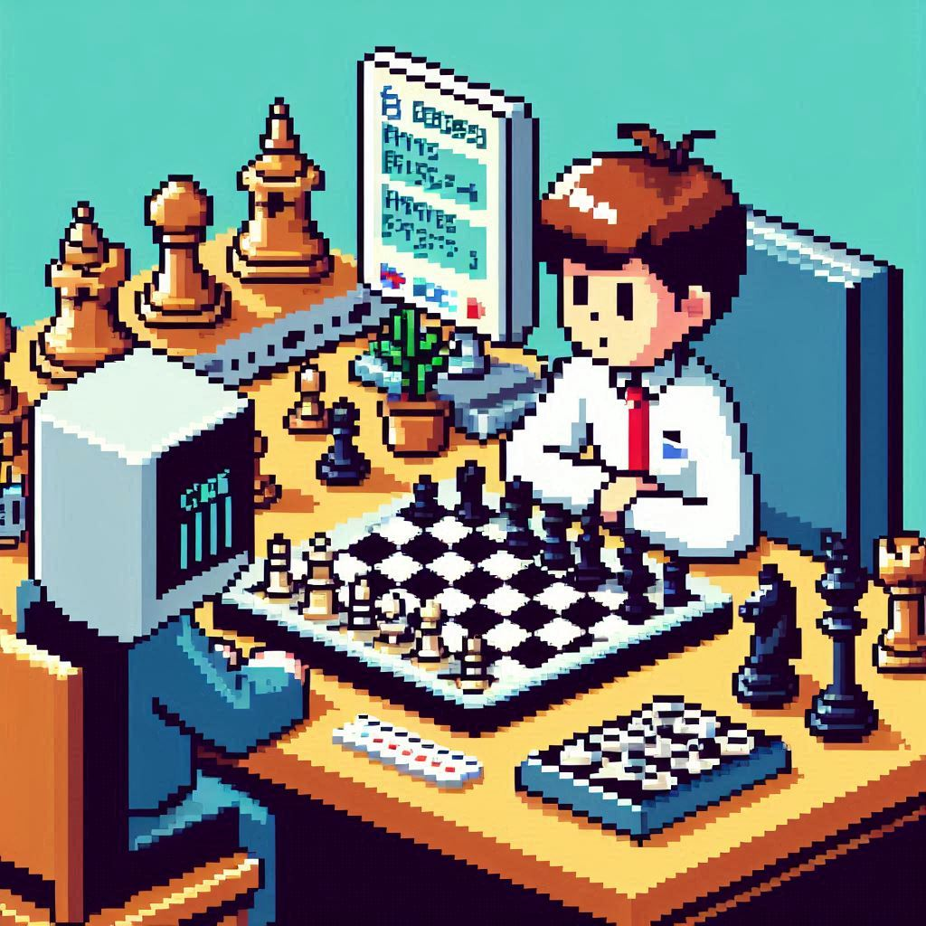



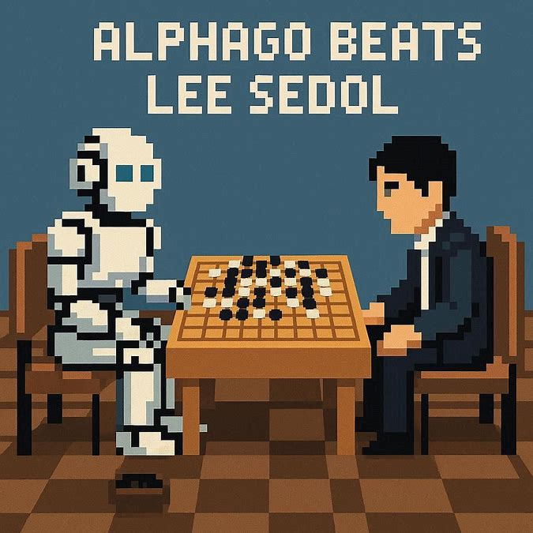
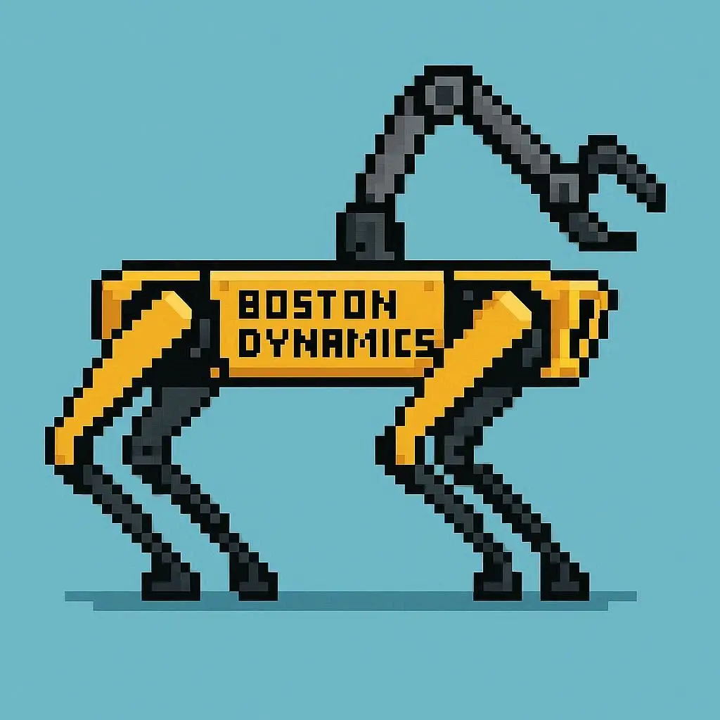


Notes:
When IBM's chess-playing computer Deep Blue defeated Kasparov in 1997, there were complains that Deep Blue had only used "brute force methods" and it wasn't real intelligence. Notably, it was John McCarthy who complained.
Alphago beat Sedol in 2016 – and barely a blip on the news.
Additionally, McCarthy would also criticize how widespread the AI effect is by saying "As soon as it works, no one calls it AI anymore“. However, he thought Deep Blue wasn’t a good example of AI – demonstrating even someone widely regarded as “The father of AI” is swayed by the AI Effect.
https://en.wikipedia.org/wiki/Michael_Kearns_(computer_scientist)
Michael Kearns suggests that "people subconsciously are trying to preserve for themselves some special role in the universe". By discounting artificial intelligence people can continue to feel unique and special. Kearns argues that the change in perception known as the AI effect can be traced to the mystery being removed from the system.

Slide 27
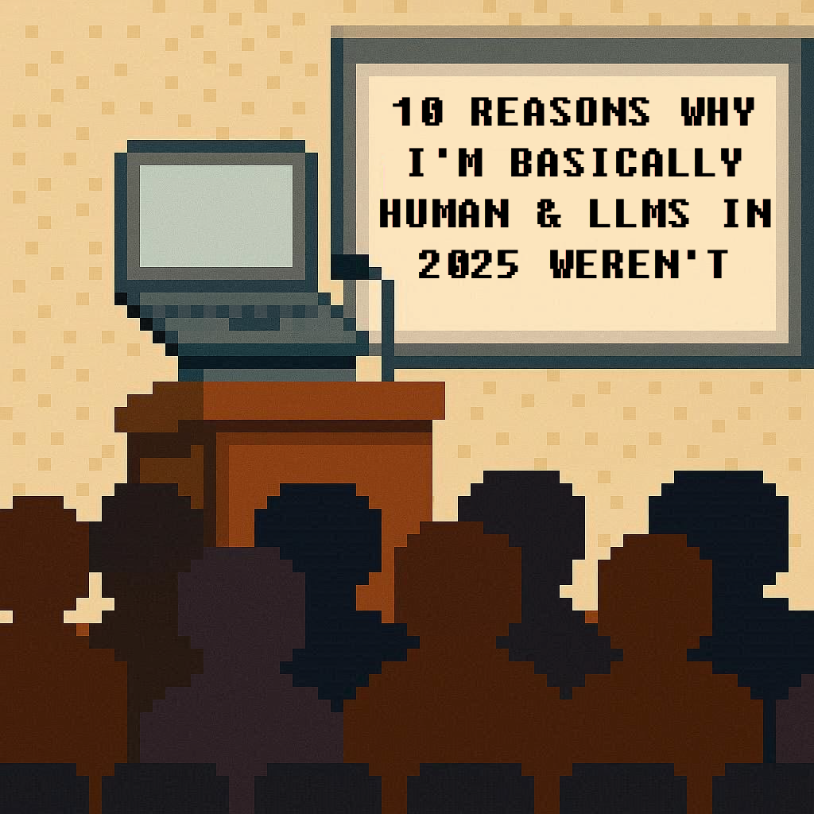
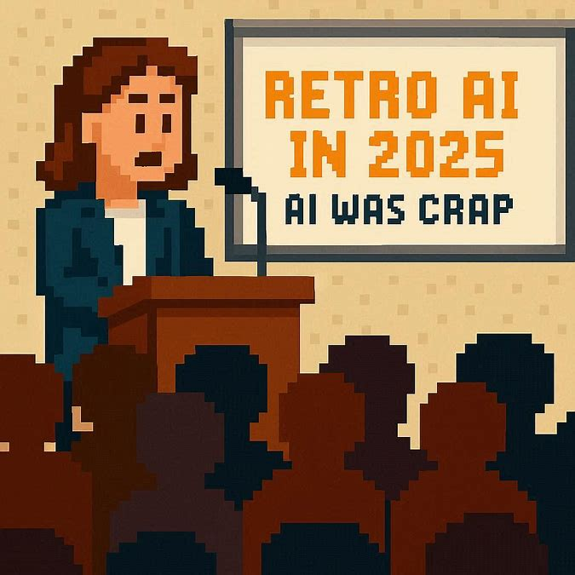
40 YEARS INTO THE FUTURE

Slide 28
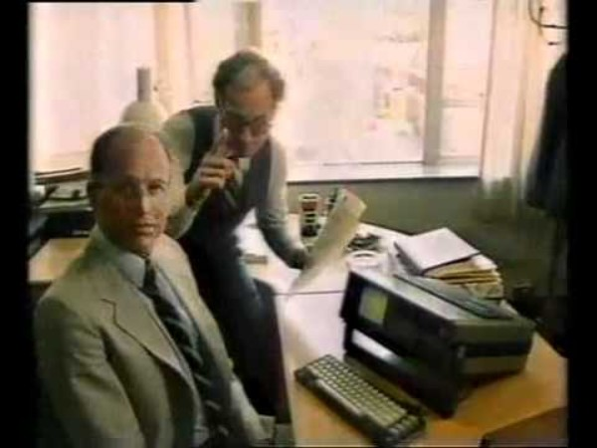
THANK YOU!
SPECIAL THANKS TO
DENNIS C. DIETRICH
FOR HELPING WITH THE DEMOS
AND DEMO OPTIMIZATIONS
Rachel Appel
rachel@rachelappel.com
Repo with BASIC programs
https://jb.gg/AI-64
Notes:
https://www.youtube.com/watch?v=5PygDf6E94o&ab_channel=BASICthinking

